Slide 1
Low-Fi Prototype & Testing
Neha Chetry, Victoria Ding, Ingrid Fan, Isha Kumar

Slide 2
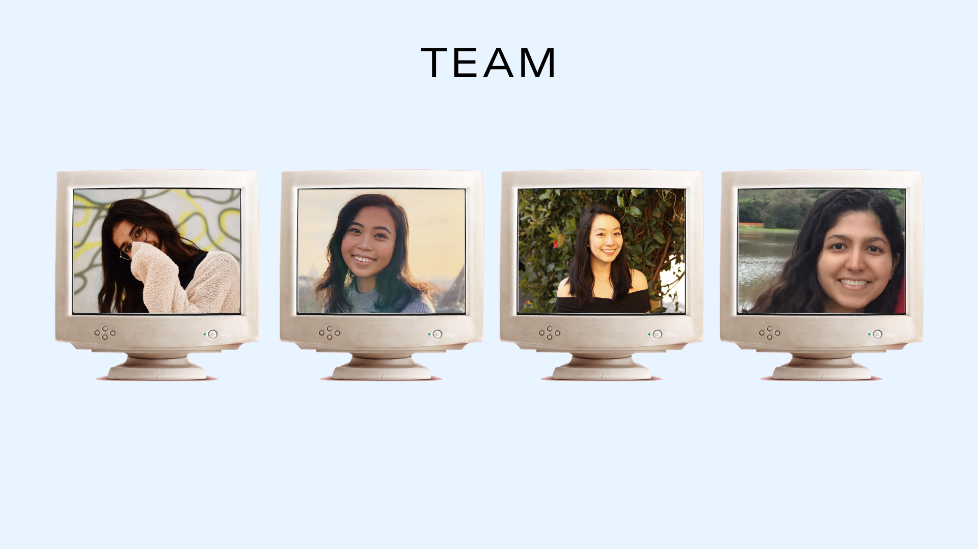
Isha K.
Ingrid F.
Victoria D.
Neha C.

Slide 3
THE PROBLEM
Leveraging mental health resources is currently laborious yet ineffectual, making the prioritization of wellbeing feel burdensome.
THE SOLUTION
A resource navigation tool that is more visually soothing, reflective, and action oriented.
Student Burnout

Slide 4
MISSION STATEMENT
Transforming student wellbeing into an effortless, effective and personalized social experience.
VALUE PROPOSITION
Let your personal wellness visualization curate resources best suited to you, reflect your self-care commitments, and source support from loved ones.

Slide 6
Encounter personalized wellness programming without the stress of the search

Slide 7
Two simple focus areas: location suggestions, algorithmic matching scale.
Map feature: Casual discovery of wellness programs rather than scheduling them in.
Matching feature: Creates an accessible scale of how to prioritize events.
Constant reminders based on location tracking may be invasive.
Quality of app is location dependent: if you live far from things it may be difficult to get utility
Focus on personal use encourages less social engagement

Slide 8
Receive an actionable bouquet of resources designed to accomplish your goals.

Slide 9
Motivated to take care of your bouquet.
Continuous calibration of resources restructures wellness as action oriented & flexible.
Ability to see journal entries to view your progress.
Requiring a daily journal entry may be too demanding.
Bouquet visualization may restrict the demographic of users.
Focus on personal use encourages less social engagement
Notes:
(Task wise & personality wise)

Slide 10
Integration of a social component.
Map feature: Enabling relaxed discovery of wellness programs
The wellness bouquet/visualization and its attention to action
Matching feature: providing a tailored metric by which users can rank resources
Requiring weekly rather than daily journaling

Slide 11
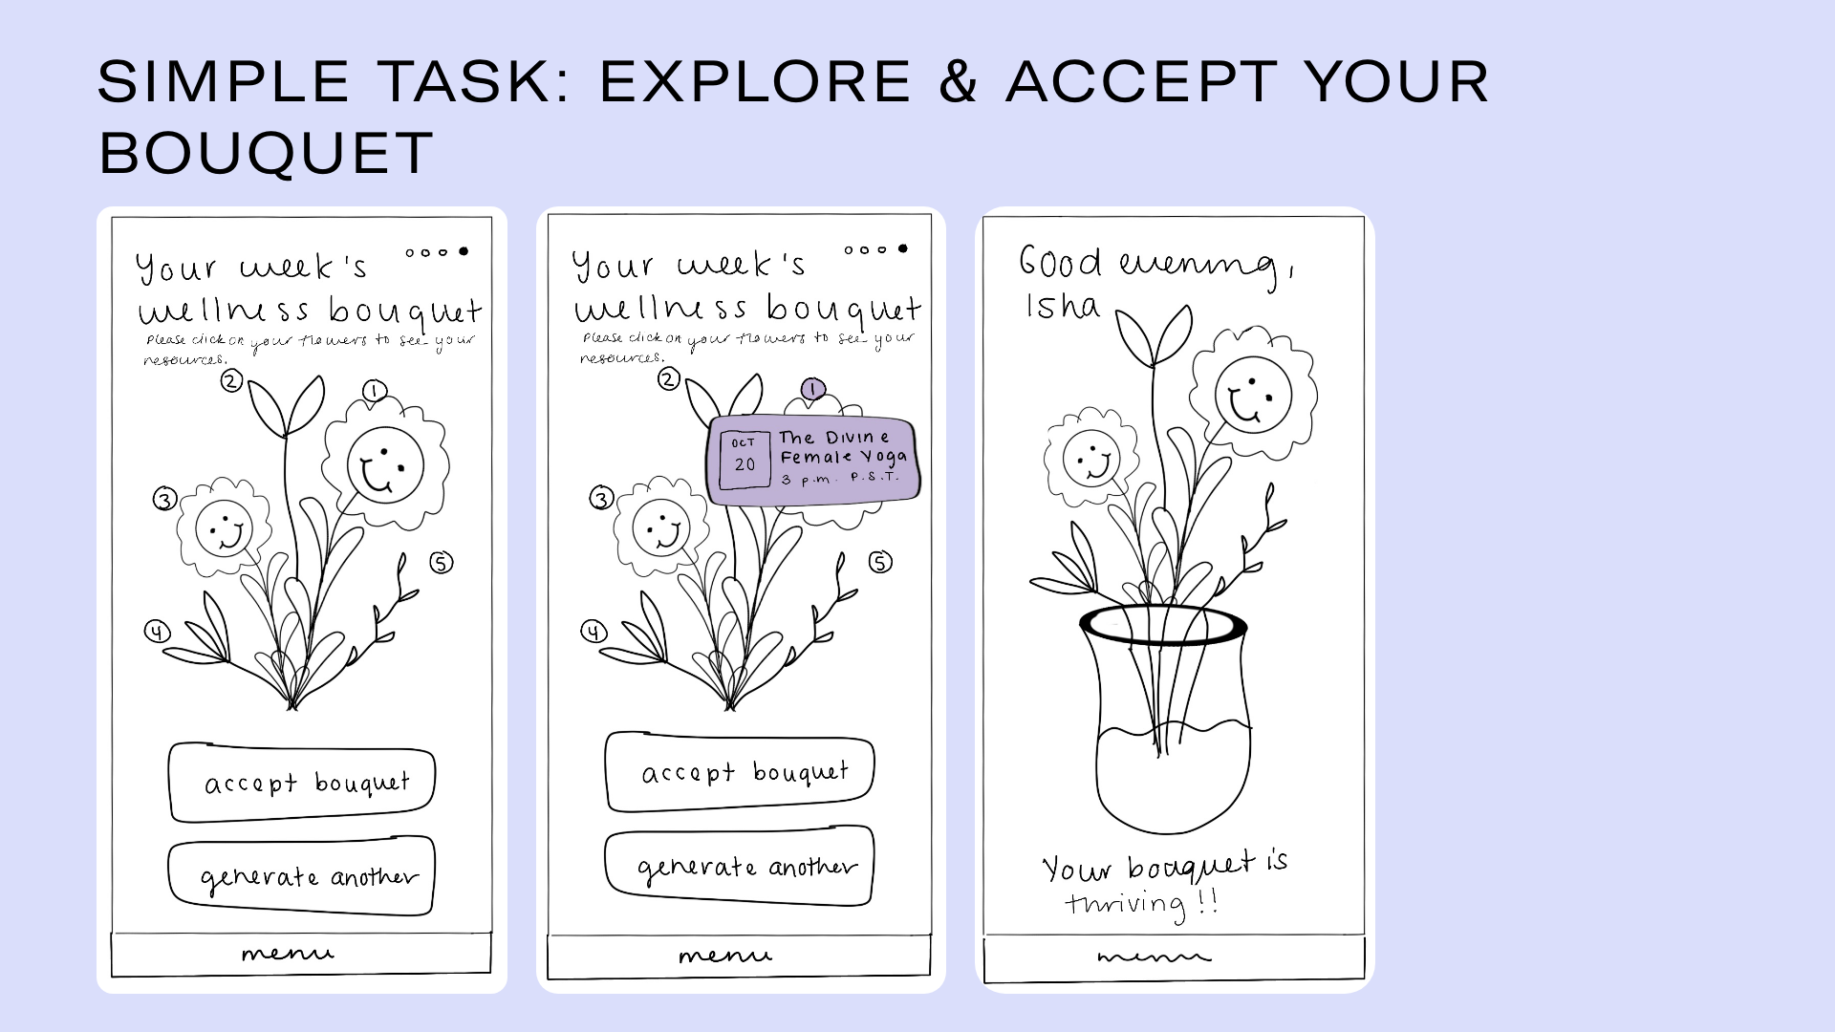
Low activation energy
Two simple user actions

Slide 12
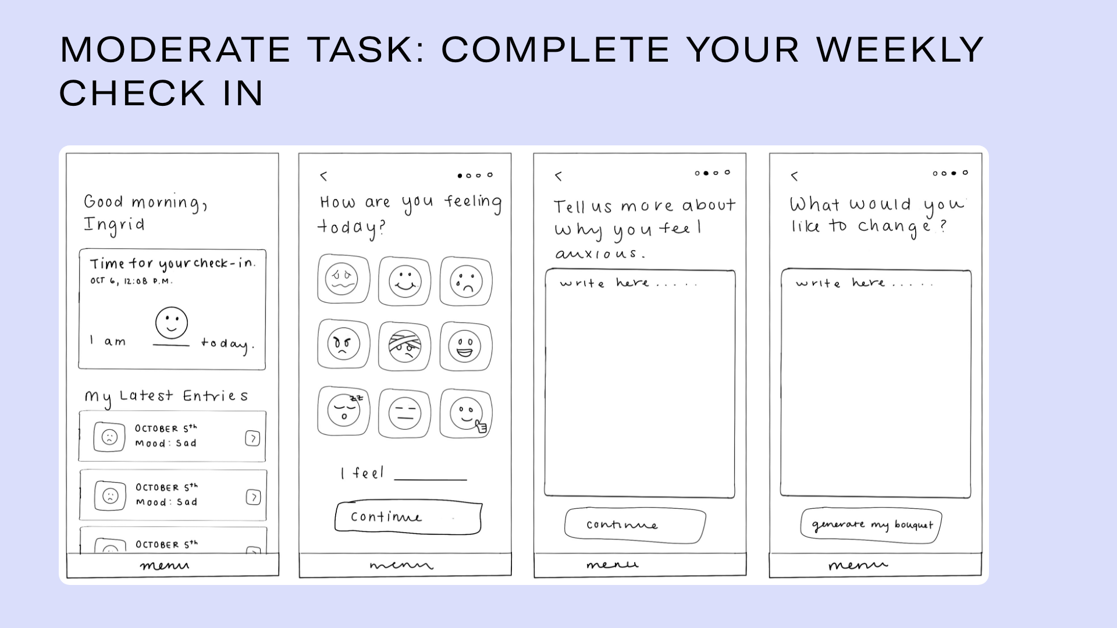
Journaling is a big ask
Requires more cognitive action matching + interpreting + writing

Slide 13
Horizontal Scroll
Record Audio
2 complex user actions: horizontal scroll and voice recording
Largest number of user actions in total
Feature anticipated to be useful to power users

Slide 14
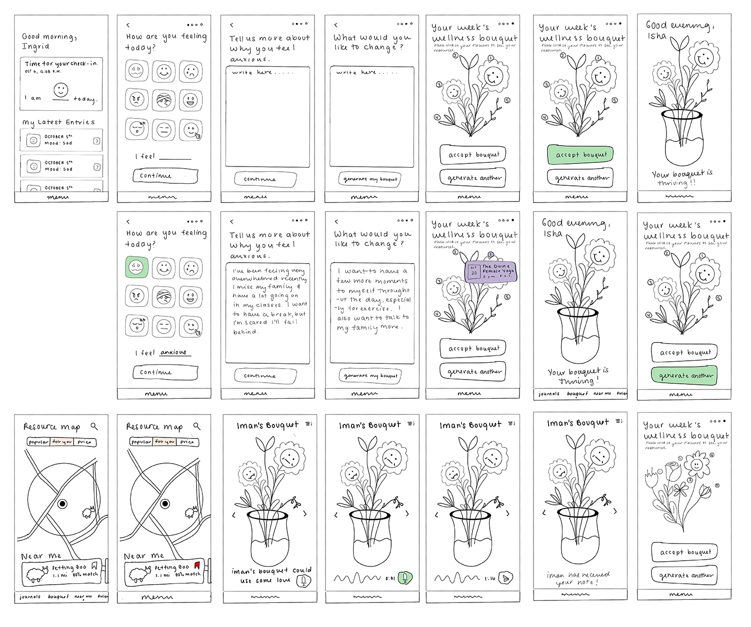

Slide 15
COMPUTER
FACILITATOR
OBSERVER

Slide 16
5 PARTICIPANTS
20s-30s AGE RANGE
REDDIT RECRUITED VIA
5-8 minutes
Notes:
Procedure: Zoomed participants and asked them to share screen as they went through the Marvel interface

Slide 17
Overall positive response to concept.
Users appreciated the hand drawn feel.
Most positive engagement was with the most visual portions of the prototype (e.g. emojis, flowers)
Emojis may be too restrictive
Initial confusion with language for journal prompts
Lack of clarity about the relationship between the bouquet and resources
Users kept wanting to modify prior choices (go back)

Slide 18
Provide other visualization options
Make the navigation more intuitive
Clarify the bouquet metaphor.
Restructure the language of journal prompts
Add more back buttons
Explore privacy concerns r.e. bouquet sharing.
Reduce the text-heavy appearance of the journaling task flow

Slide 19
Questions?

Slide 21
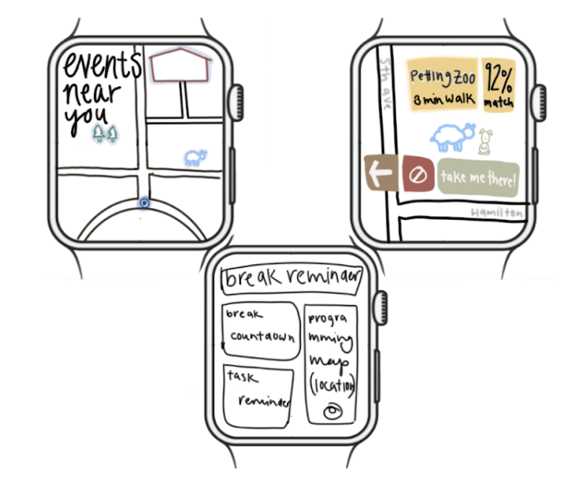
Top 2 Design Ideas (Initial)

Slide 22
Top 2 Design Ideas (Initial)

Slide 23
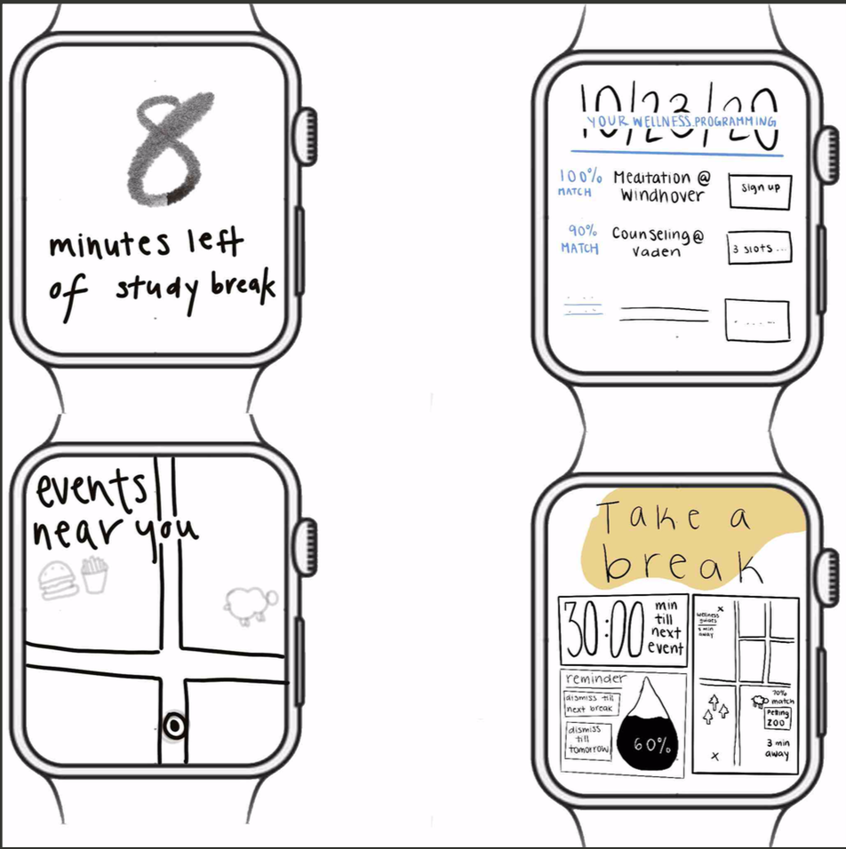
Top 2 Design Ideas (Final)

Slide 24
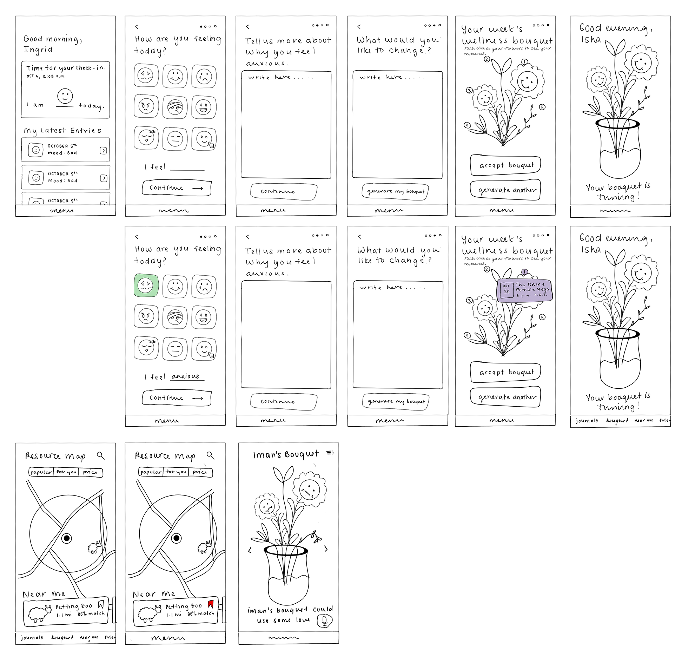
Top 2 Design Ideas (Final)

Slide 25
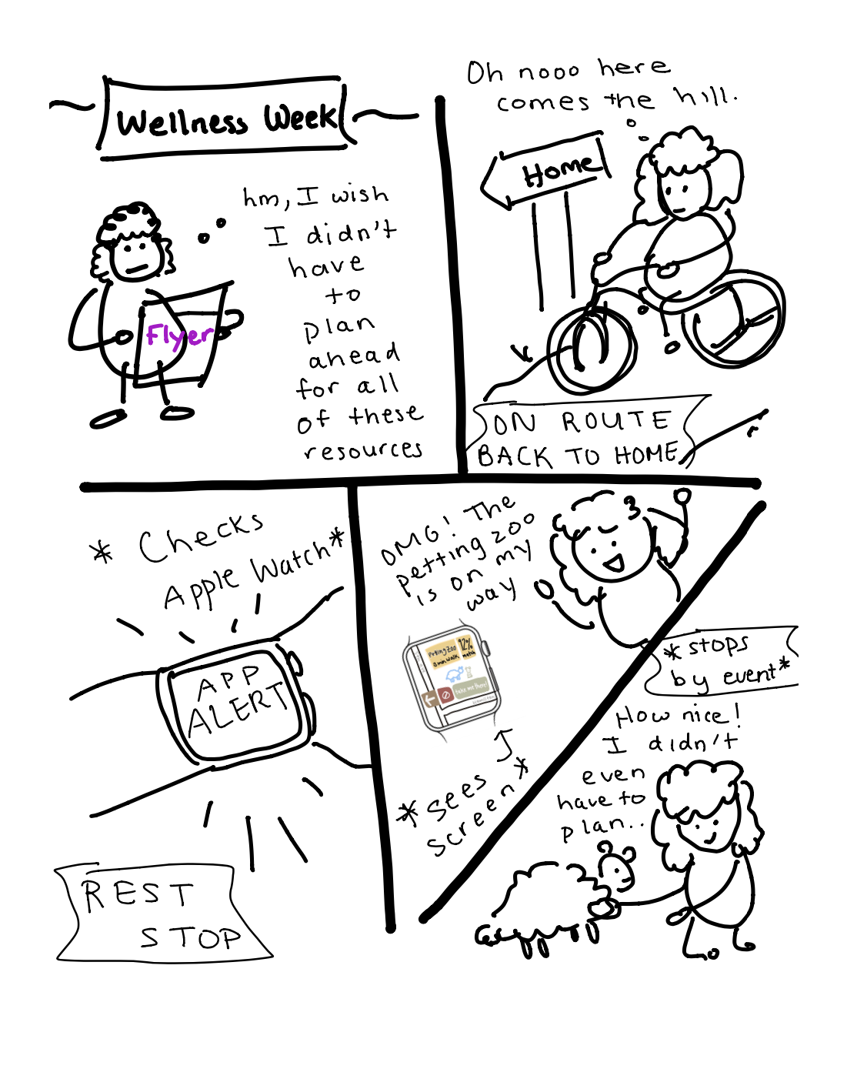
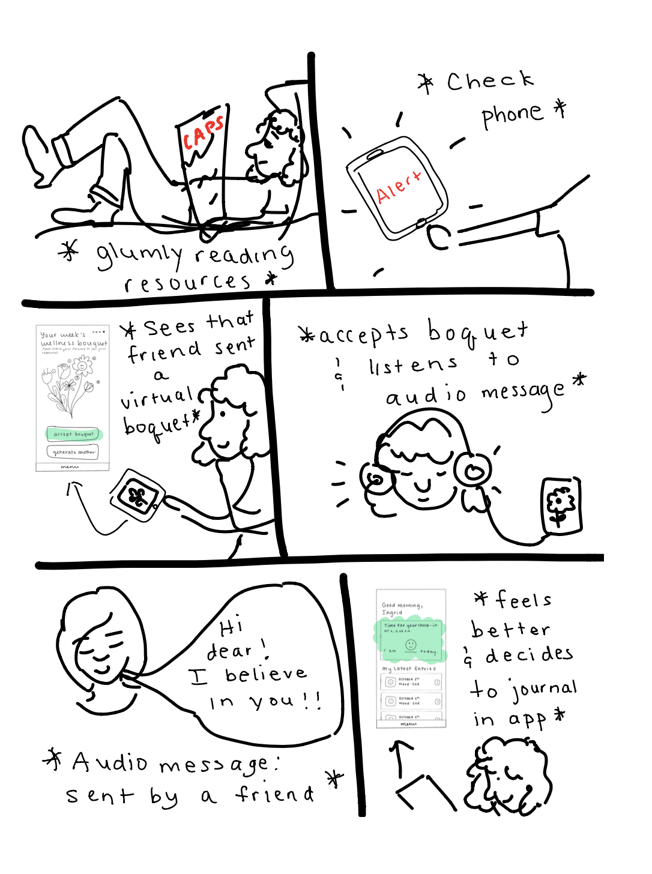
Top 2 Designs Storyboarded
Casual Discovery
Wellness Bouquets

Slide 26
Prototype Description
Please see here for our complete prototype

Slide 27
Critical Incident Table: Participant 1
Incident | Severity ranking
“Wow I already feel relaxed” (in response to seeing home screen) | 0
Smiled at smiley faces and clicked on first one | 0
“So cute!” in response to seeing bouquet | 0
“How do I go back to accepting the bouquet.” | 2
“Huh? I don’t get it” (while clicking on flowers for resources) | 3
“Wait is that audio? Why.” | 3
“Are there more emoji options? Is this it?” | 3
“How do I change my response?” (for emojis)” (midway through) | 3

Slide 28
Critical Incident Table: Participant 2
Incident | Severity Rating
I like the layout of the emojis to show emotions | 0
Can I choose emotions beyond these emojis? | 1
Is this a bored face? I don’t know what some of these mean. | 2
What am I trying to change? Something about myself or something about my day? | 3
Clicked accept bouquet before clicking on resources first | 3
What does it mean to accept or generate another bouquet.
I like the audio idea. | 0
Kind of sketchy that you can see someone else’s bouquet. | 3

Slide 29
Critical Incident Table: Participant 3
Incident | Severity Rating
Appreciate the time indicator for journals. | 0
Finds drawings funky. | 1
Confused because emoji’s are in random order, rather than sorted from happy to sad. | 2
Cannot go back. | 1
Does not feel like filling out journal prompts (elaboration on why you are anxious) | 2
Wording of “what would you like to change?” is off putting. | 2
“Interesting” in reference to bouquet | 0
Confused on audio portion; can you type a message instead? | 1

Slide 30
Critical Incident Table: Participant 4
Incident | Severity Rating
“Oh nice” [when looking at emojis] | 0
Clicked “Accept Bouquet” before exploring the resources in it. Then said “What do I do now?” | 3
“How do I go back?” | 3
“Some of the text is hard to read.” | 1

Slide 31
Incident | Severity Rating
“Why do all the past entries say October 5?” | 1
“None of these emojis describe how I’m feeling.” | 2
“What if I’m in crisis mode?” [while selecting emojis] | 3
“What does this mean?” [in response to “What would you like to change?” screen] | 2
“Why is my bouquet thriving? What does that mean?” | 2
“It’s so cute!” [in response to the bouquet] | 0
“The audio message is a nice idea.” | 0
“I don’t know how I feel about the bouquets being public.” | 3
“I like the hand-drawn feel to the app. It feels very relaxing [even though the hand drawing is for the prototype].” | 0
Critical Incident Table: Participant 5

Slide 32
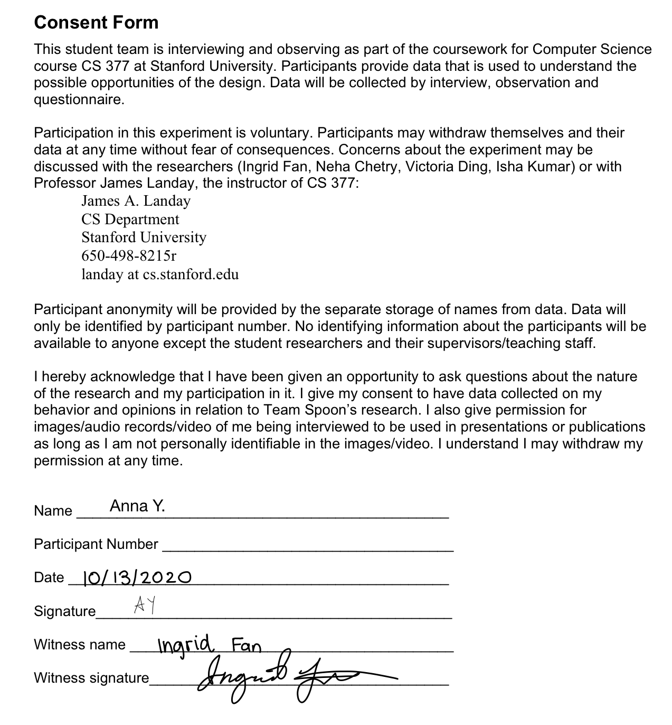
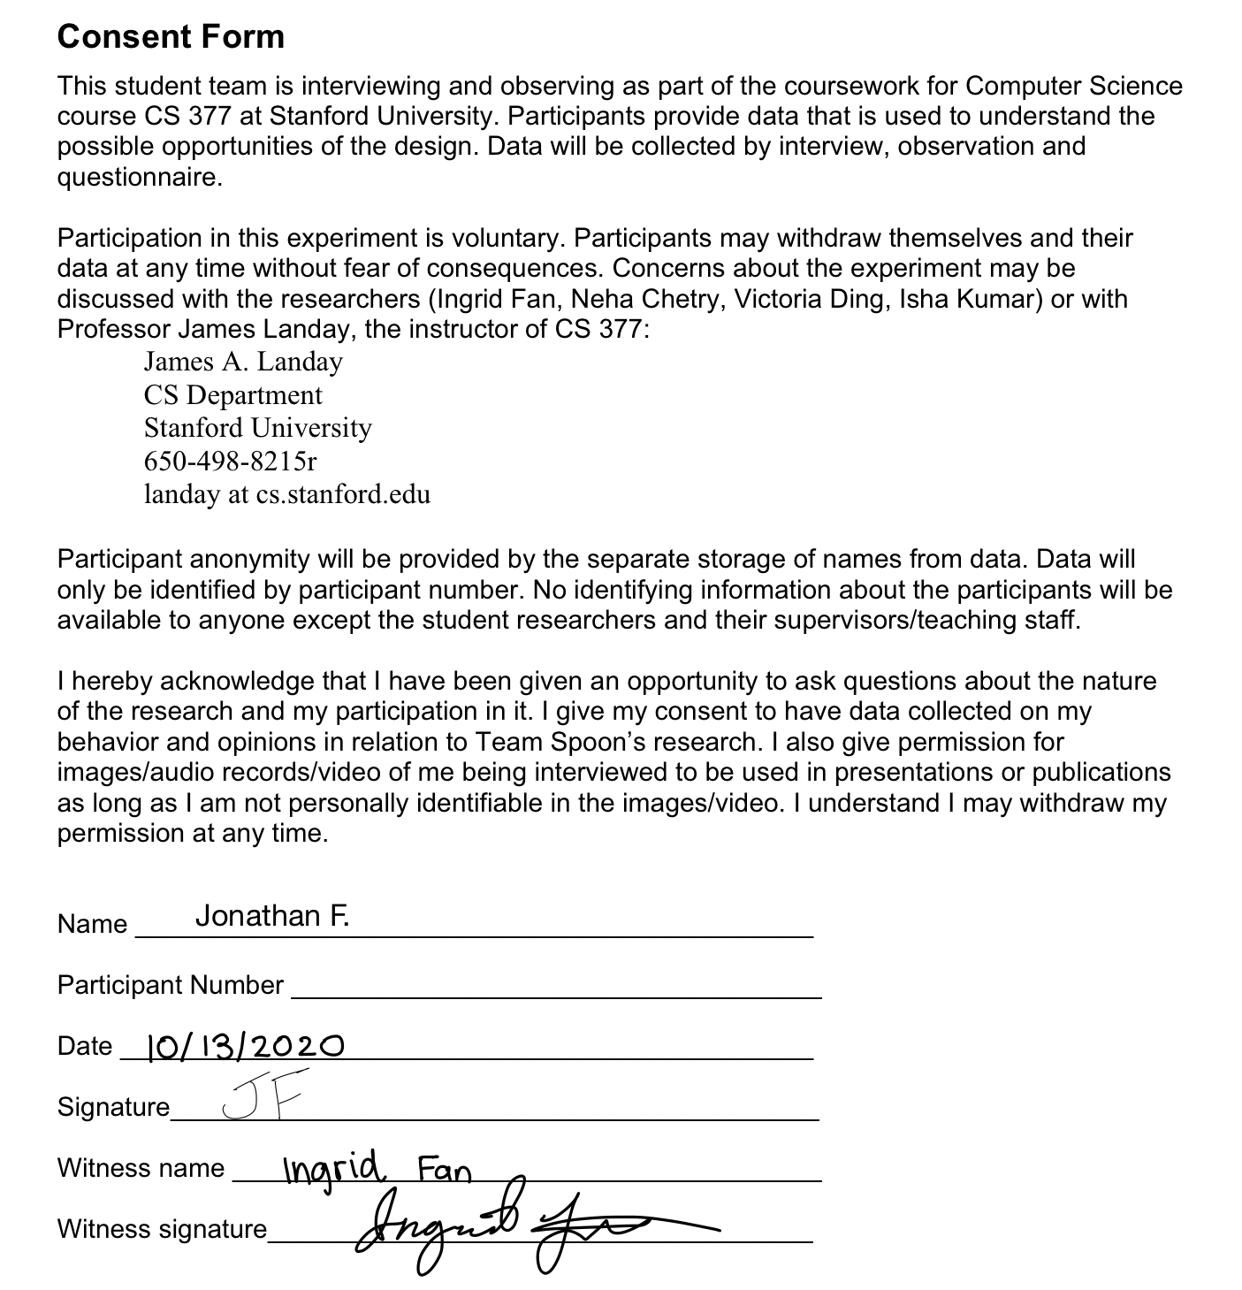
Consent Forms

Slide 33
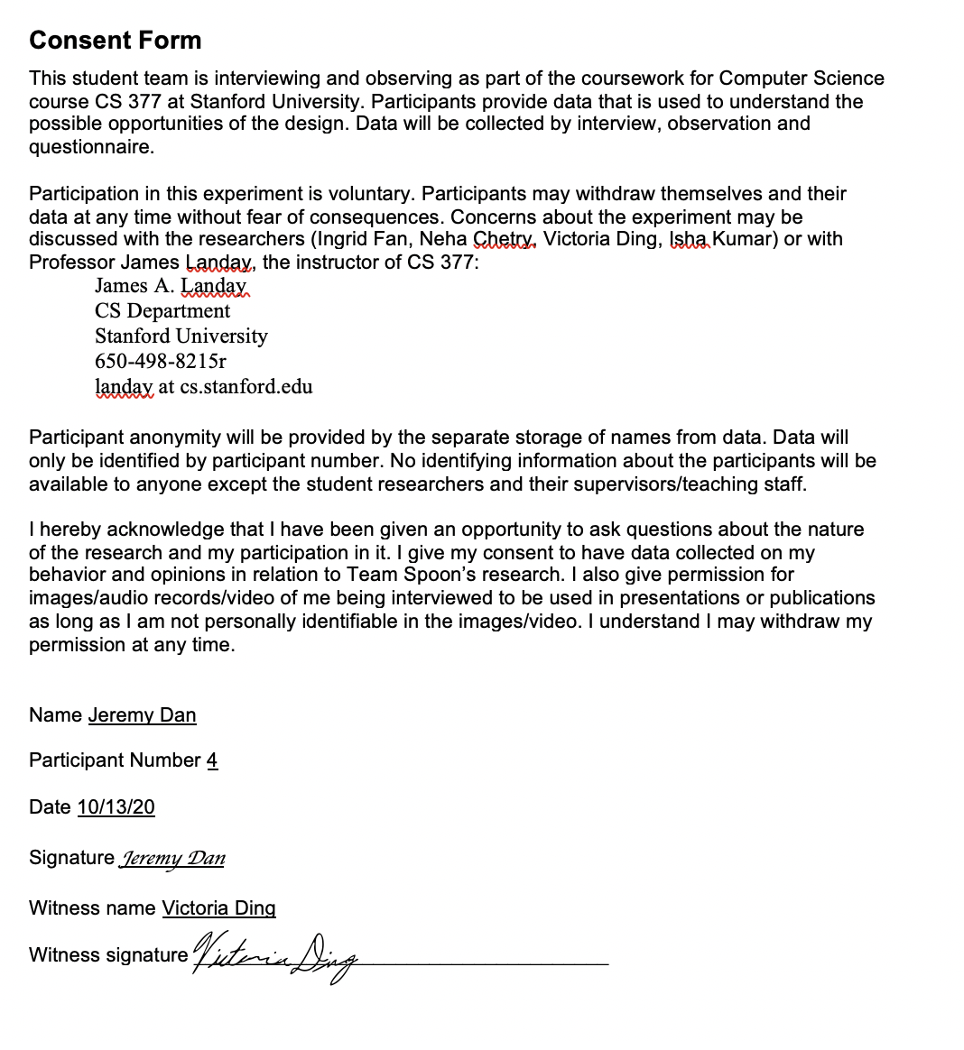
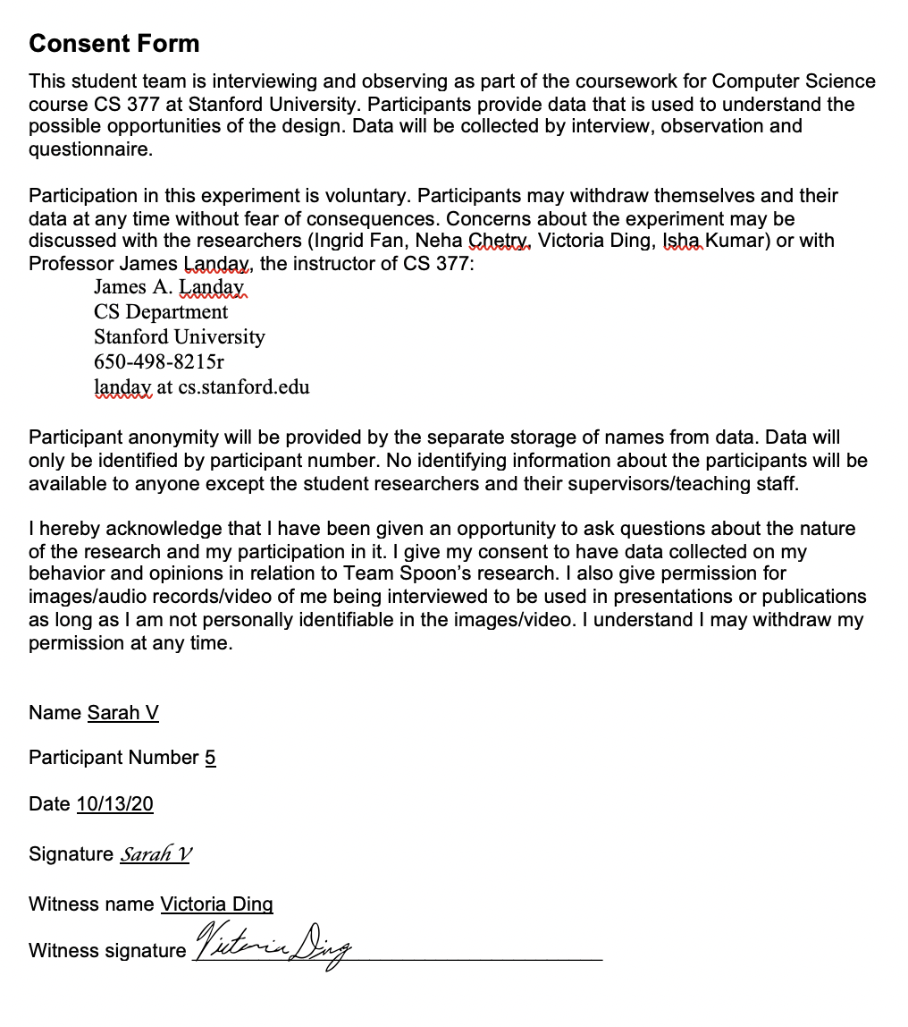
Consent Forms

